Slide 1
NOTE COUNTING PIGGY BANK
COLLECTING UNIT
DISPLAY UNIT
STORING UNIT
DISPATCHING UNIT
On/Off (semi-automatic)
Sense the note/currency according to its colour
Dropping of note into the box after passing through sensor
provision to receive the note if we want to withdraw
Provision to insert the note
Display amount/ currency added)
Store the note
Display balance after transaction
Hold the note
Display the number of notes before and after transaction
Drop the note

Slide 2
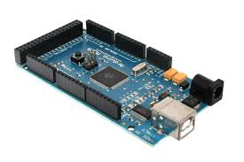
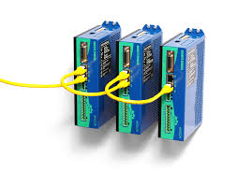
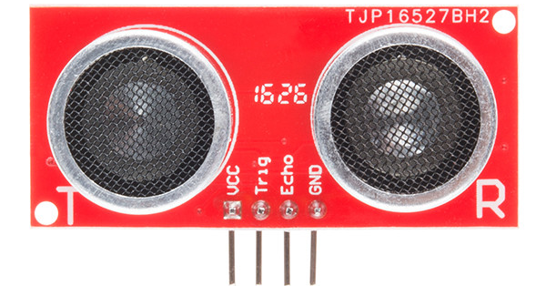
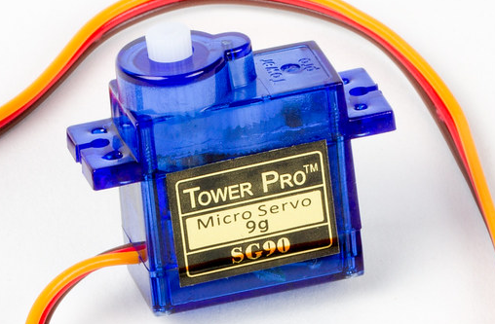
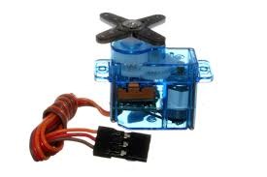
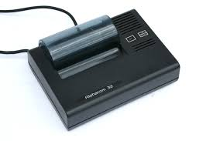
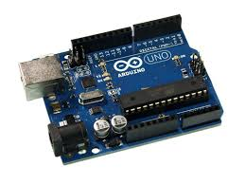
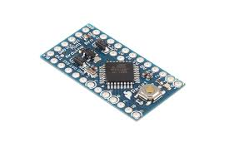
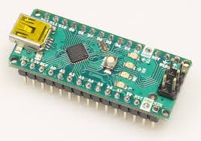
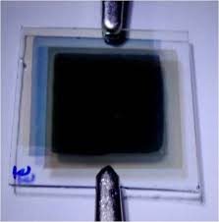
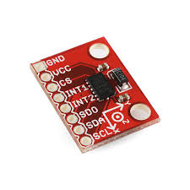
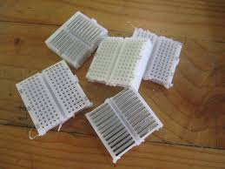
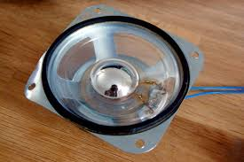
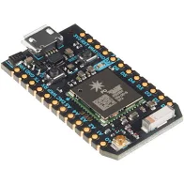
SMART PIGGY BANK
(COMPONENTS USED)
OPTION 1 | OPTION 2 | OPTION 3 | OPTION 4
Ultrasonic sensor | Ultrasonic sensor | Arduino mega | Servo motor
Micro servo | Small servo motor | Thermal printer | Amplifier
Arduino mini | Arduino nano | Electrochromic film | Accelerometer
Mini Breadboard | Mini Breadboard | Adafruit Wave Shield | Photon

Slide 3
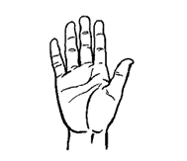
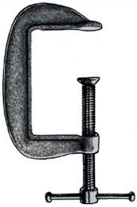
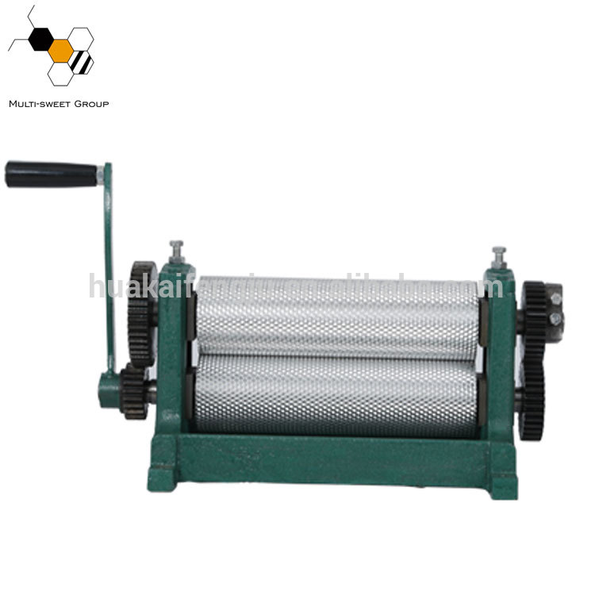
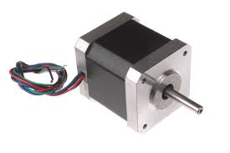
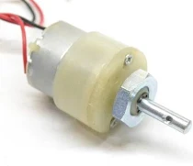
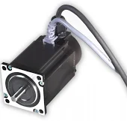
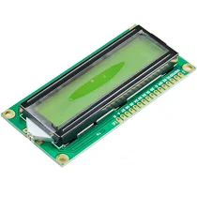
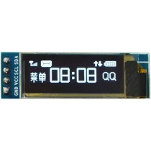

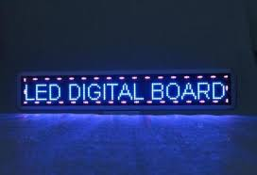
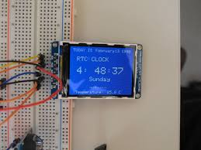
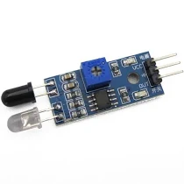
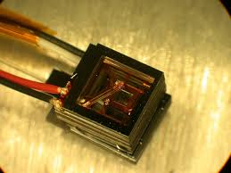
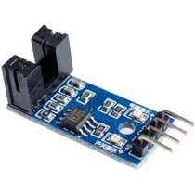
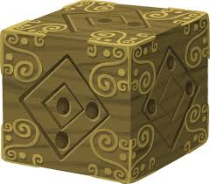
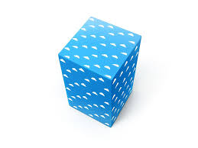
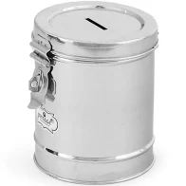
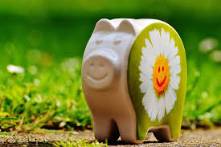
Functions | Mean 1 | Mean 2 | Mean 3 | Mean 4
Holding a note | Hand | clamp | roller
Displaying unit | LCD | LED | OLED | TFT
Sensing of note | Ultrasonic sensor | IR sensor | Magnetic sensor | Optical sensor
Model shape | Cube | Cuboid | Cylindrical | Pig shape

Slide 4
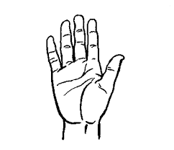
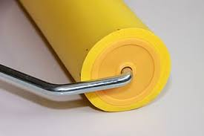
Holding a note | Hand | Clamp | Roller

Slide 5
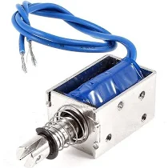
Linear Servo Motor

